Slide 1
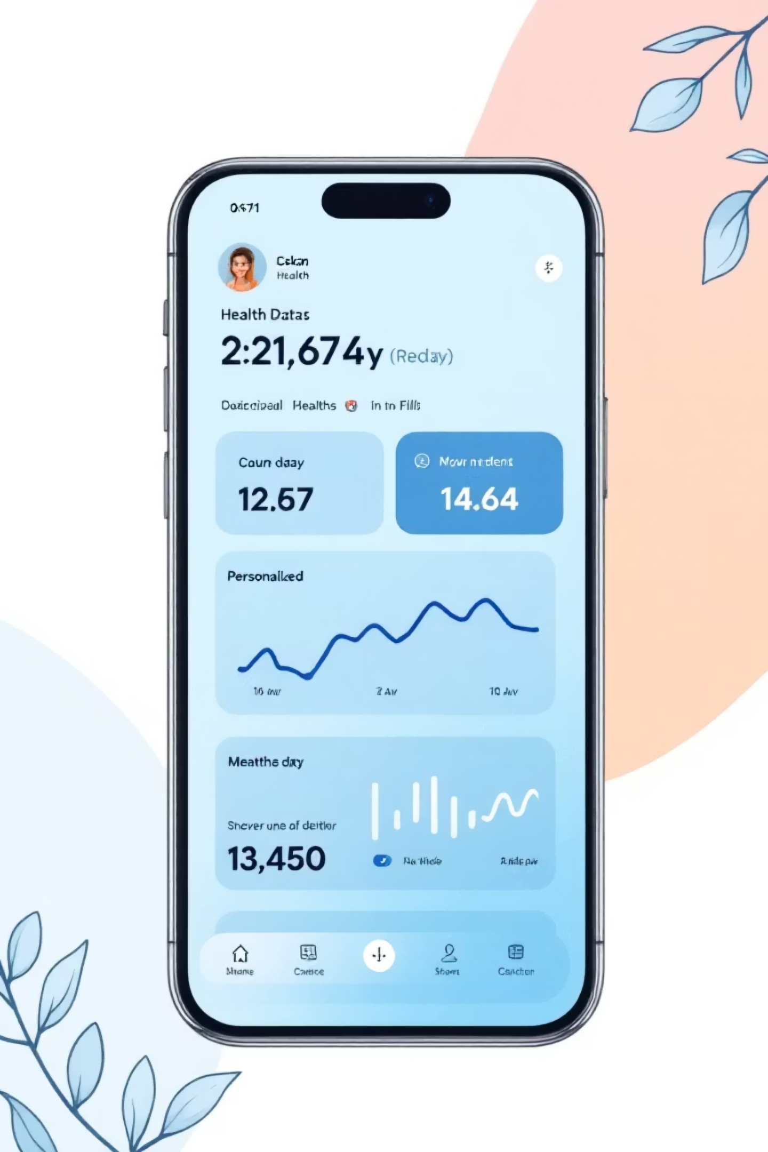
Freakquency
Your Personalized Path to Smarter Health Decisions: Leveraging AI for Preventative Care in Underserved Populations.

Slide 2



The Challenge
Preventable Chronic Disease is an Epidemic of Unawareness
Unrecognized Risk
Access Barrier
Under-Managed Health
Millions develop conditions like diabetes, hypertension, and heart disease because they are unaware of their risk until it reaches a critical, costly stage.
Proactive prevention and early screening are difficult due to limited access to primary healthcare, especially in low-income or rural regions.
Current patient-facing tools lack personalized, actionable steps needed to intervene early and manage health effectively before symptoms escalate.

Slide 3



Bridging the Gap: Our Target Users
Freakquency is designed to democratize preventative health data, focusing on those most in need of early, accessible intervention.
Low-Access Regions
Proactive Individuals
Pre-Consultation Clarity
Individuals in rural or underserved areas with limited regular access to primary care physicians or health screenings.
Users seeking clear, data-driven, and actionable guidance on lifestyle changes to actively reduce their future health risk.
Users who want to understand their baseline risks and specific areas of concern before scheduling a professional medical consultation.

Slide 4




The Solution
Freakquency's 4-Step Personalization Engine
We transform simple user input into sophisticated, personalized preventative health roadmaps.
Input Questionnaire
AI Risk Prediction
User provides basic data: age, BMI, blood pressure, lifestyle habits, and family history.
AI predicts user risk for key chronic diseases: diabetes, cardiovascular disease, and cancer.
Tailored Guidance
Human-in-the-Loop
AI generates personalized, incremental recommendations for diet, exercise, and monitoring.
Users review, adjust, and prioritize recommendations to ensure alignment with personal goals and feasibility.

Slide 5
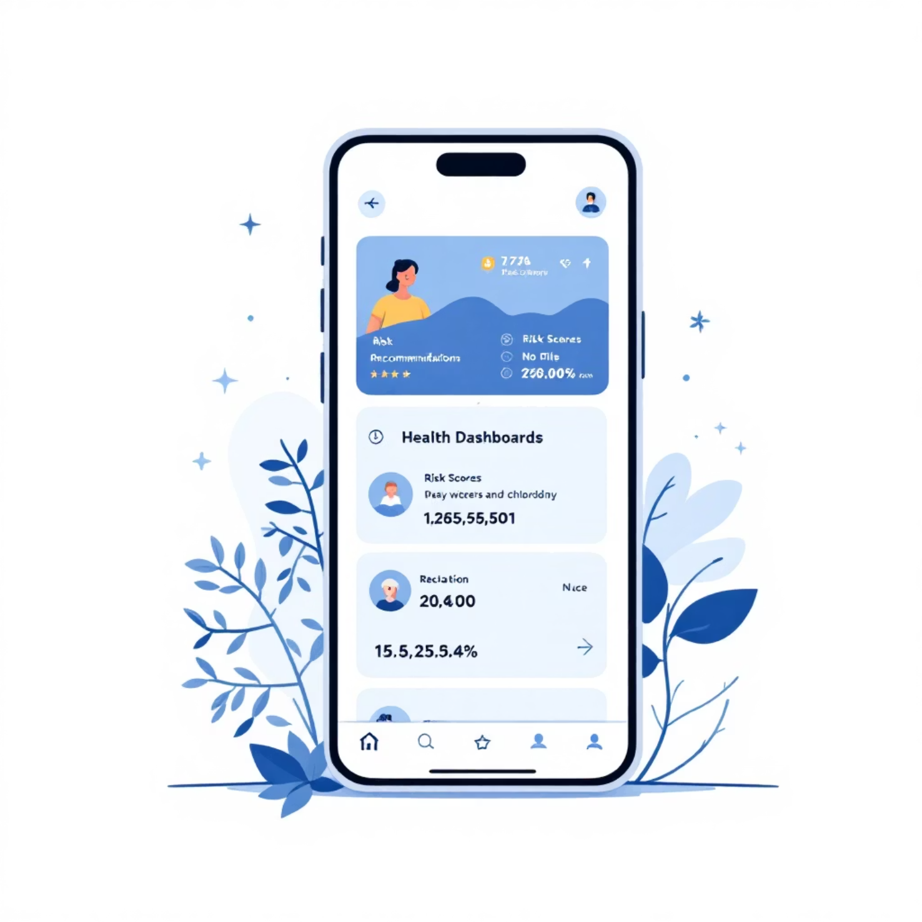
From Input to Action: The User Journey
Data Input: BMI, Blood Pressure, Family History, and habits are collected via a secure, streamlined interface.
Risk Visualization: Probability scores for each condition (e.g., Diabetes: 45%) are displayed with clear color-coding (low, medium, high).
Recommendation Output: Concrete daily and monthly lifestyle goals are generated, focusing on reducing the highest-risk areas.
Self-Correction: Users can accept, modify, or swap out goals to maintain motivation and adherence.

Slide 6

The Engine Room
Freakquency's Dual-Layer AI Algorithm
Layer 1: Predisposition Calculator
Layer 2: Adaptive Recommendation Engine
We employ a robust Random Forest classifier model, trained on diverse health datasets, to accurately predict future chronic disease risk based on the user's initial inputs.
This layer uses the predicted risk and current user habits to generate highly personalized, incremental lifestyle recommendations for diet, exercise, and preventative monitoring.
The system is designed for continuous learning, adapting recommendations as user feedback and health data evolve over time.

Slide 7



Projected Impact: Why Freakquency Matters Now
Our solution offers scalable, impactful benefits for both individuals and the wider public health system.
Early Awareness
Healthcare Equity
Actionable Change
Promotes early, informed awareness of chronic disease risk, enabling timely intervention.
Provides crucial, accessible preventative support to underserved populations and low-access areas.
Encourages sustainable lifestyle shifts through small, achievable, and personalized goals.

Slide 8

Security & Ethics: Building Trust Through Transparency
Data Minimization (MVP): No personal data is stored beyond the current session, ensuring immediate user privacy.
Future Compliance: Plans include end-to-end encryption and compliance with global standards (HIPAA, GDPR) for secure data handling.
Transparent AI: We prioritize interpretable models, ensuring users understand why a risk was predicted and how the recommendation was generated.
User Control: Users always maintain ultimate control over their data and have the final say in adopting or modifying their personalized health plan.

Slide 9




Future Vision and Expansion Roadmap
Our initial prototype is just the beginning. We aim to integrate Freakquency into comprehensive healthcare ecosystems.
UI/UX Integration
Data Expansion
Implement the algorithms into a professional, scalable Figma-designed user interface.
Integrate with wearable devices and extend prediction to more chronic conditions (e.g., mental health, respiratory).
Deployment Strategy
Ethical Oversight
Pilot programs in public health clinics and low-resource community centers for validated deployment.
Establish an advisory board to continually review ethical standards and AI model bias.

Slide 10



Conclusion
Empowering Health, One Step at a Time
Freakquency is more than just a risk calculator; it's a tool for behavioral change, providing actionable insights that encourage proactive lifestyle adjustments. Our mission is to empower individuals to manage their health before problems arise.
Help people understand their risk, take small, incremental steps, and live significantly healthier lives.

